Slide 1
Instructions for the Research Question Demos
You have 3 minutes to present – be ready to share your screen, practice first. We can only offer you one opportunity to present so please make the most of it.
Research Questions are dependent on the variables and datatypes you have in your chosen dataset. Before going ahead with defining your Research Question, your dataset DSXXXX must match your assigned Dataset, I.e., did you check the dataset assignment list on Slack (Announcements)? Your group number must be assigned to the dataset you are referencing here.
The next few slides give you three alternatives for how to define your research question and hypotheses. You will select only one type of research question. Before presenting DELETE all the texts that are either instructions or options you do not use (including this slide). You can then enlarge your selection.
We will send you instructions as to how to sign up. Sign up early. When the space runs out, we cannot issue any further. DO NOT SIGN UP unless you can attend. All the group members should attend but select one person to present.
We look forward to giving you feedback. You will not be graded on this presentation but if you do not attend and you booked a space you are preventing someone else presenting and are going against our module values. This will be reflected in your peer evaluation.

Slide 2

Research Question – How does the trading volume correlate with each month of the year in the financial market data Tutorial Presentation for Feedback Date: 04/11/2024
Group Name: A226 Name of Student Presenting: Hariharan Baskar

Slide 3
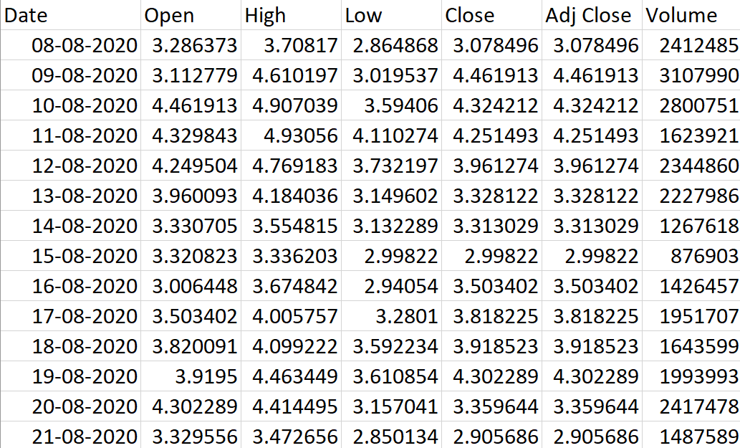

Slide 4
This dataset is interesting to us because: it allows to gain insights into investor behavior by examining the relationship between trading volume with respect to each month in a year. Our Independent variable is: Month This Independent variable datatype is: Interval data. Our Dependent variable is: Volume This Dependent variable datatype is : Interval data
Dataset ID: DS101 and GEEQ.csv
Notes:
Before specifying your Research Question you must define the type of data you are analysing. Are the variables you select interval data (measurement data you can divide, multiple, etc), OR are they ordinal (there is a definite order but the intervals between each variable are not necessarily equal, or the terms might be subjective like in a likert scale); OR are they just categorical/nominal (Items such as film names, cities, etc., that you can count numbers of occurrences? You also need to understand whether the variable is either dependent or independent and this will vary according to the context. Independent variables may cause an effect, whereas the dependent variable might be effected by the independent variable. Check the lecture notes on the RQ for more information and examples.
You will get only one opportunity to present your Research Question ahead of the submission date. Have your questions ready, and be ready to take notes on feedback.

Slide 5
1. Null hypothesis (H₀): There is no correlation between Trading Volume and each month in a year. 2. Alternative hypothesis (H₁): There is a correlation between Trading Volume and each month in a year.
Our Research Question is
Is there a correlation between Volume and Price volatility?

